Slide 1

Drink and Be Happy
January 23, 2019

Slide 2

Initial Questions
A Deep Data Dive
Data Collection
Data Exploration
Data Clean-up and Analysis
Conclusions
Implications
Limitations
Future Analyses
Questions
Agenda

Slide 3




Initial Questions
We’re on a mission to discover:
Happiest and saddest countries
Most drunk and most sober countries
Factors of happiness
Correlation between happiness and alcohol consumption (if any)

Slide 4



A Deep Data Dive
Where’s the information?
Data Collection
3
main sources of merged data
Google APIs – geocode latitudes and longitudes
UN World Happiness Rankings
World Bank – Total Alcohol consumption per capita
156
countries around the world
averaged datasets from
2010-2016

Slide 5
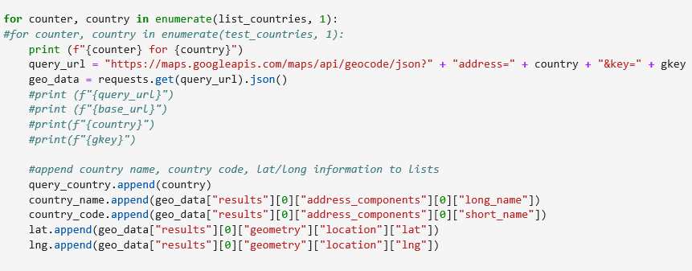
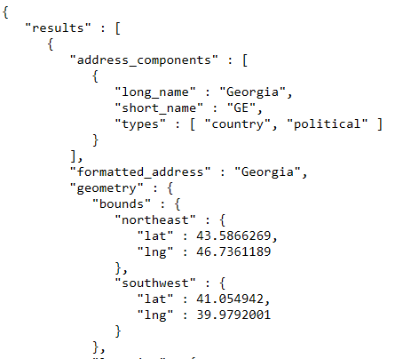
A Deep Data Dive
Where’s the information?
Data Exploration
Google APIs – geocode

Slide 6
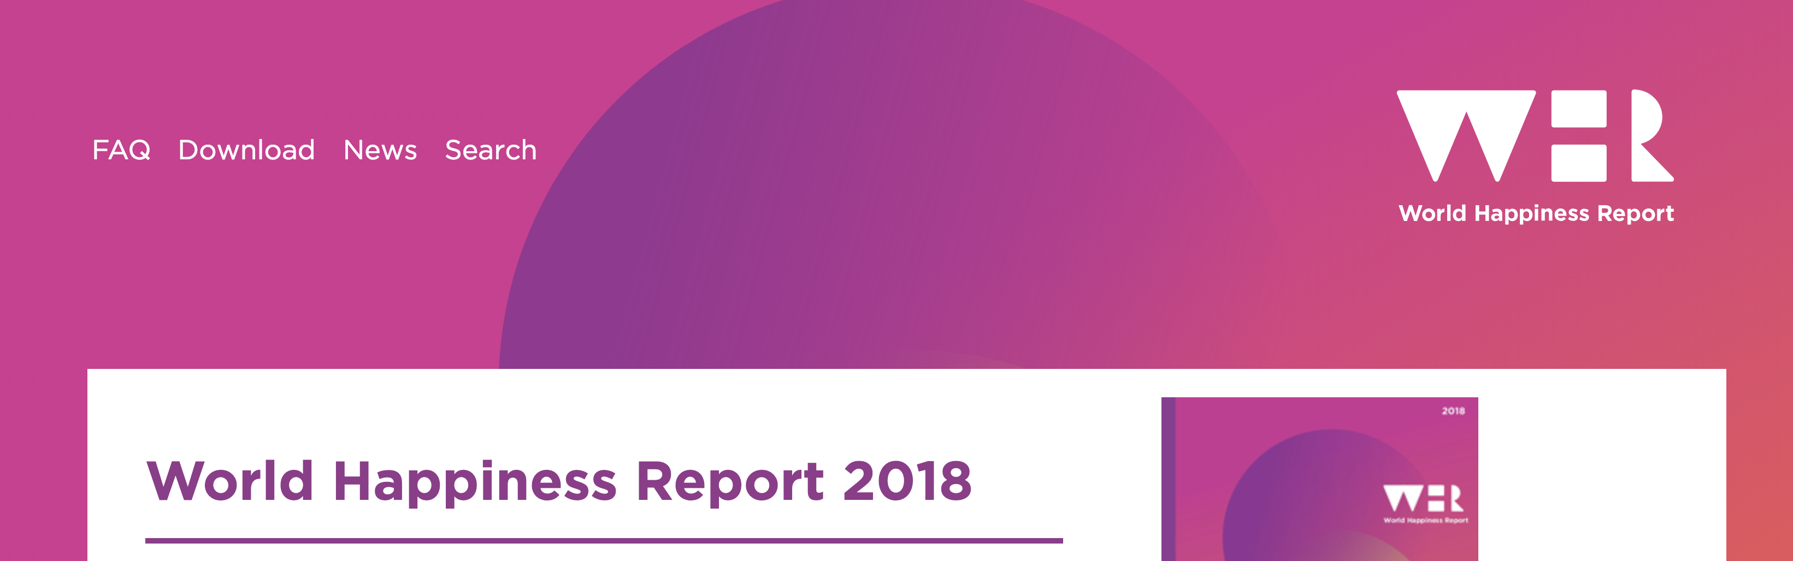
The key variables that have been found to support well-being:
Income
Healthy Life Expectancy
Social Support
Freedom
Trust
Generosity
Gallup World Poll: Cantril ladder: it asks respondents to rate their life, best possible for them being a 10, and the worst possible life being a 0. The typical annual sample is 1,000 people to reduce random sampling errors. The confidence interval is measured at 95% accuracy.

Slide 7
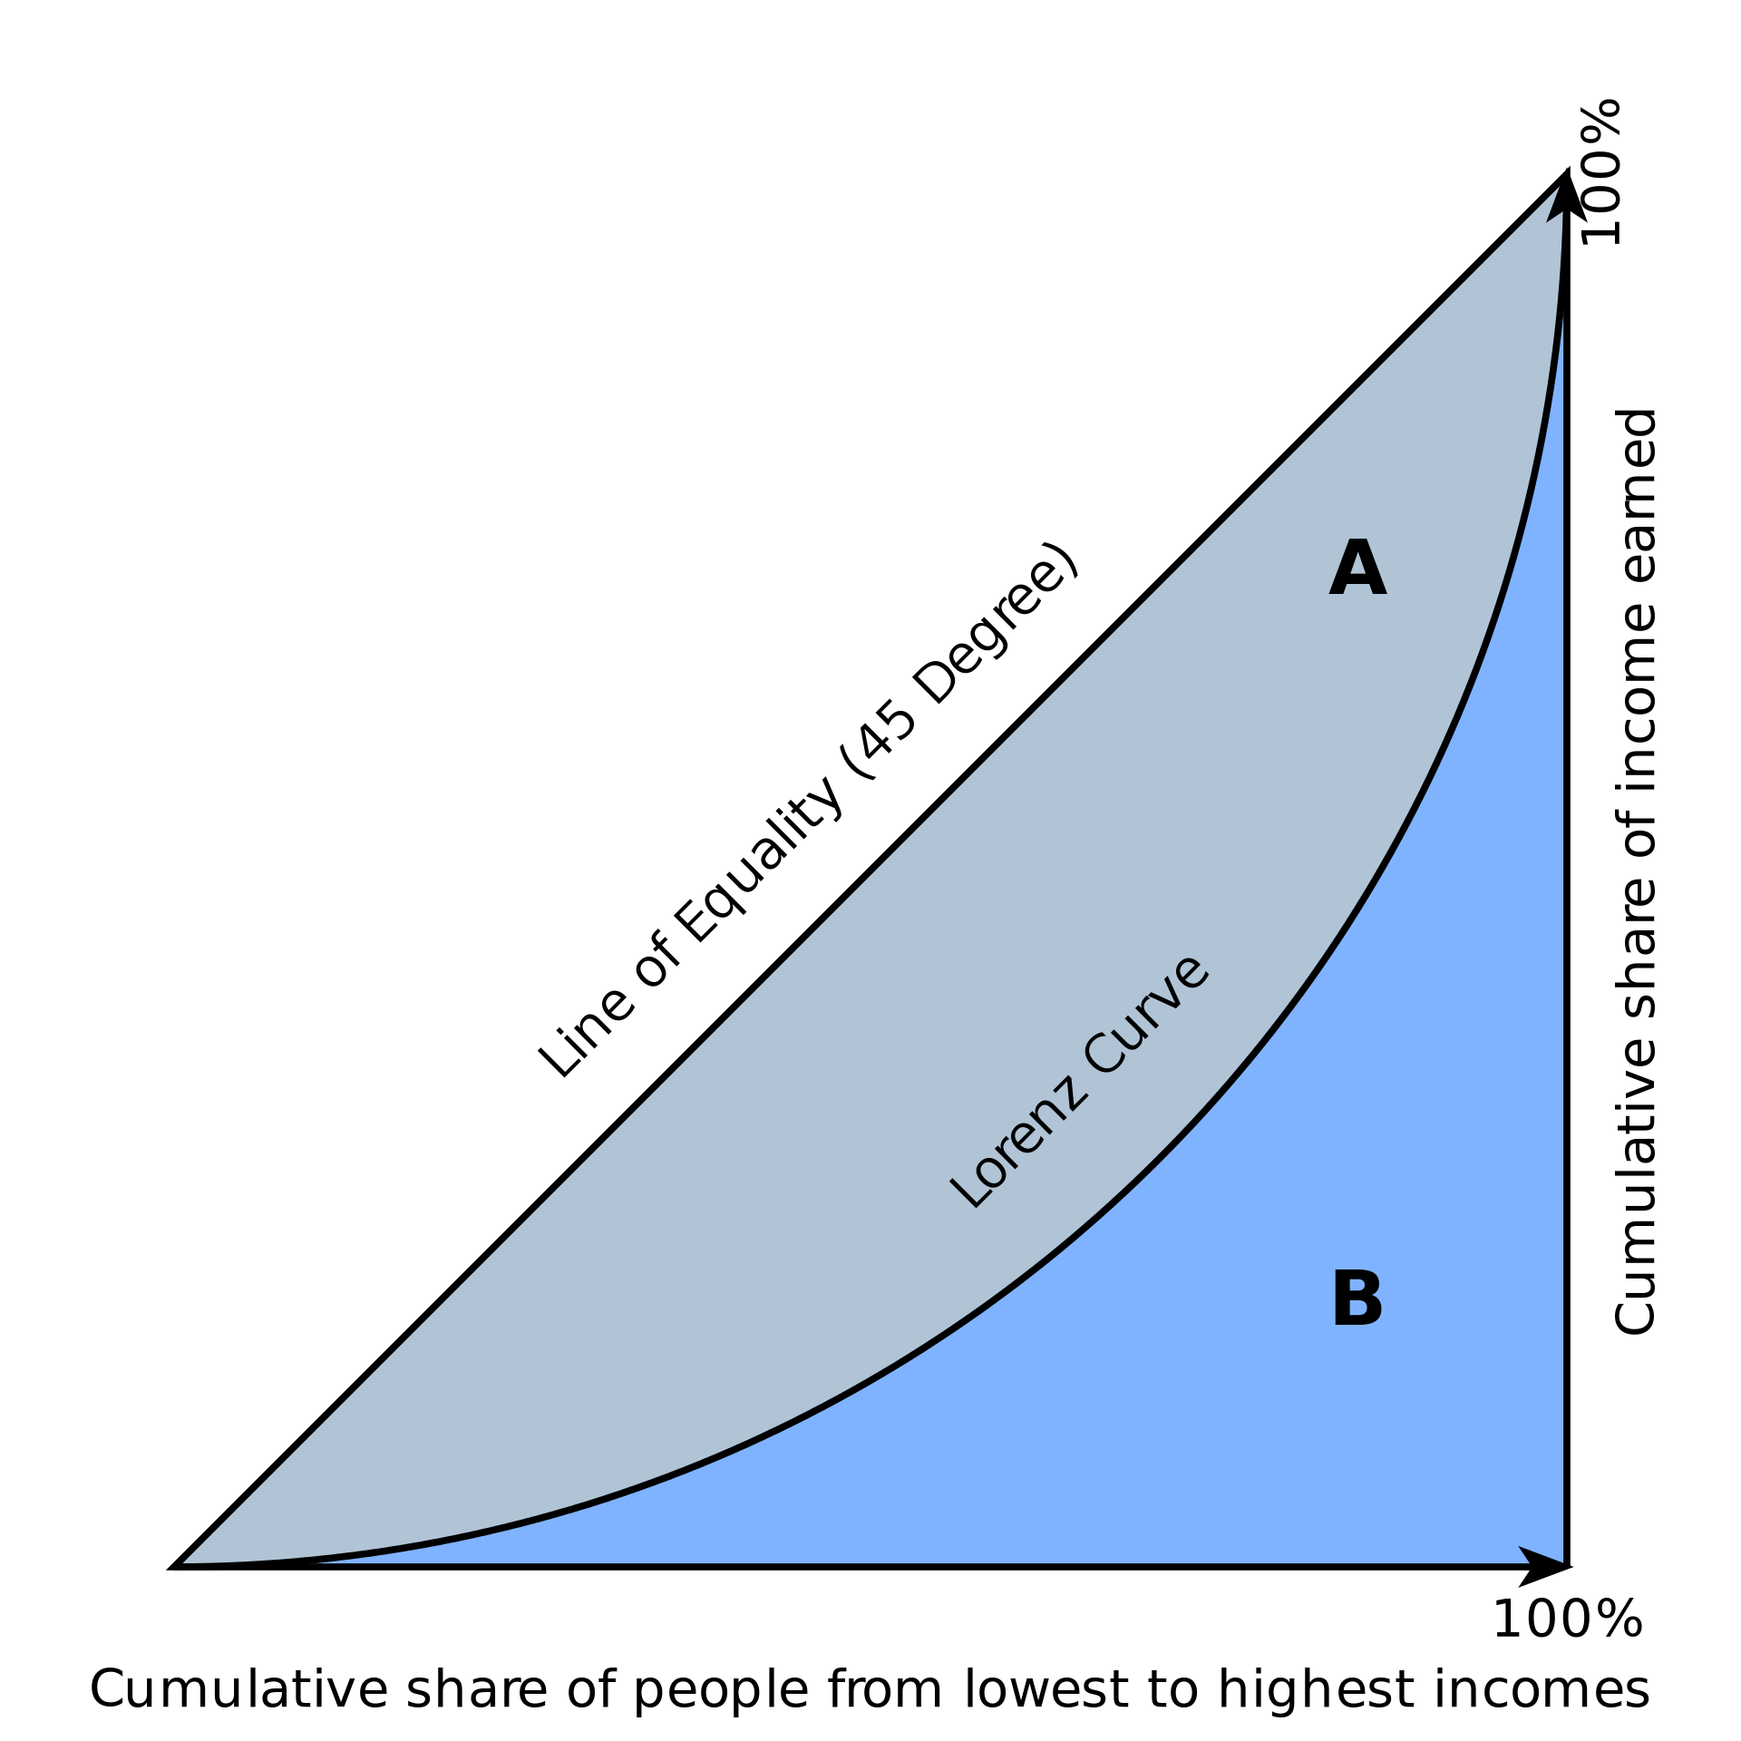
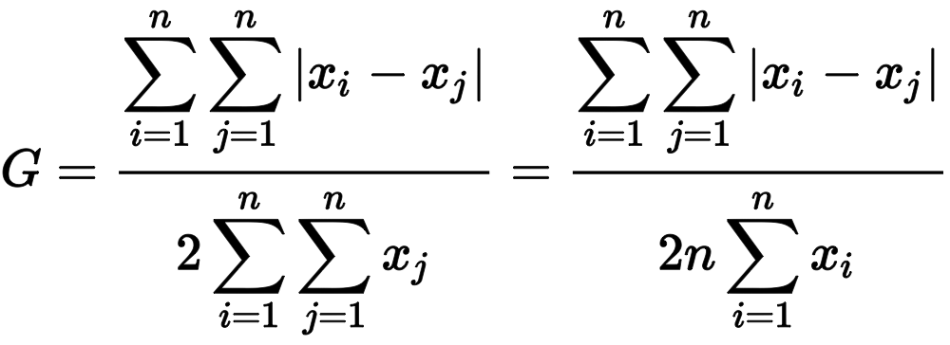
Data Exploration: Happiness Factors
UN World Happiness Rankings
The Gini Coefficient
A single number aimed at measuring the degree of inequality in a distribution. It is most often used in economics to measure how far a country's wealth or income distribution deviates from a totally equal distribution
relative mean absolute difference
which is mathematically equivalent to the Lorenz curve definition

Slide 8
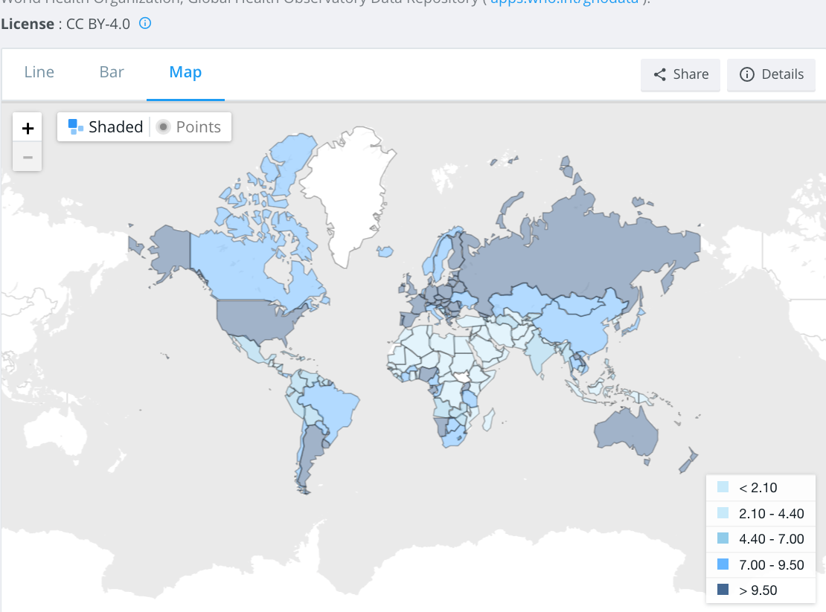
total alcohol consumption per capita
(liters of pure alcohol, projected estimates, 15+ years of age)

Slide 9


A Deep Data Dive
Where’s the information?
Data Cleanup Process
Create country master list
Determine master source of country codes and names
VLOOKUPs, comparisons between .csvs
Resolve Google API country code misalignment

Slide 10
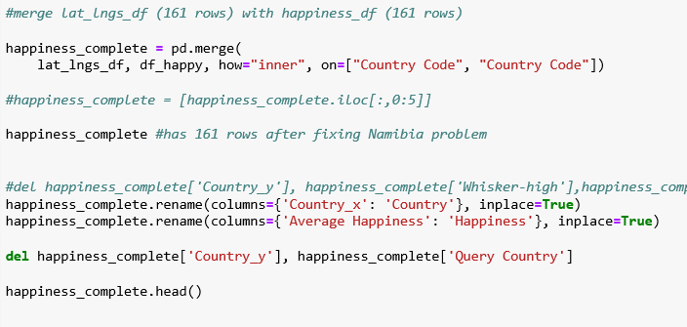

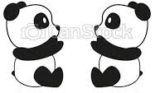
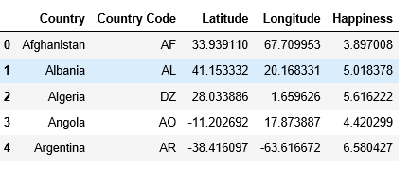
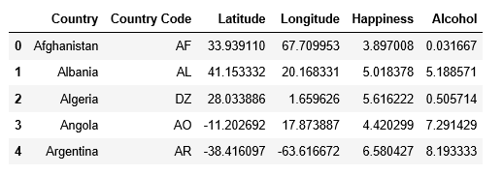
A Deep Data Dive
Where’s the information?
Data Cleanup & Analysis Process
Create Pandas DataFrames for:
Alcohol data
Happiness data
Lat/Long data
Merge Pandas DataFrames

Slide 11
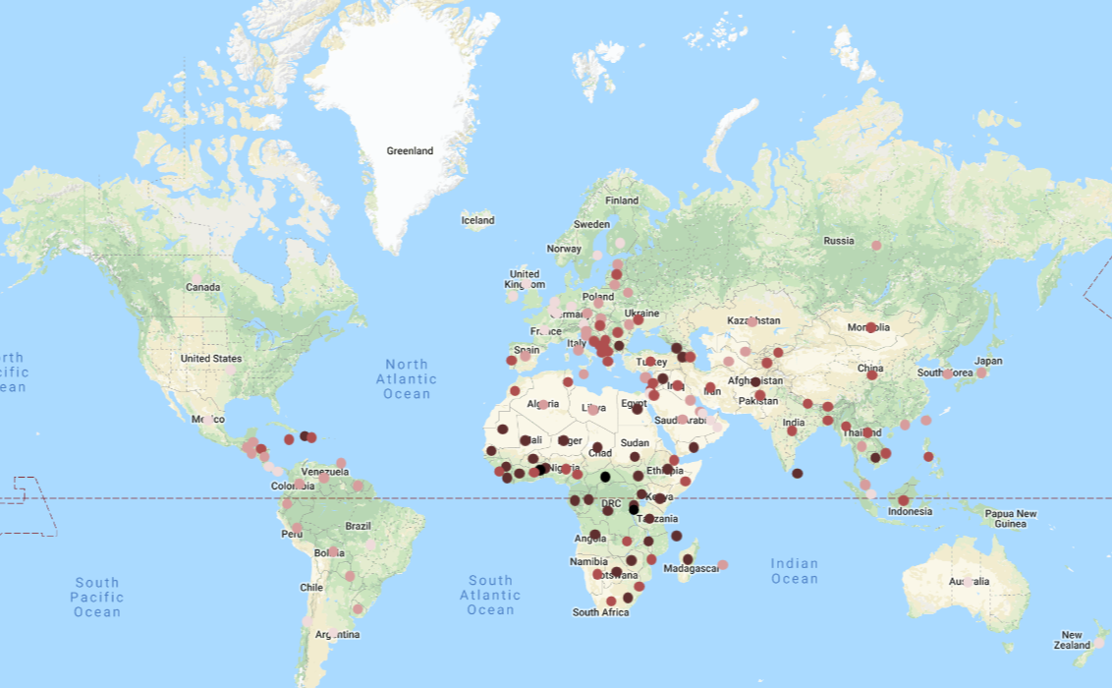
Conclusions
Happiness: mapped
What are the most/least happy countries in the world?
Happiest countries: Scandinavia (3) and (7) Europe
Least happy countries: Africa (9 of the bottom 10)
Happiness Rating of:
7.0
6.0
5.0
4.0
3.0

Slide 12
Conclusions
Happiness: mapped
What are the most/least happy countries in the world?
Happiest countries: Scandinavia (3) and (7) Europe
Least happy countries: Africa (9 of the bottom 10)
Happiness Rating of:
7.0
6.0
5.0
4.0
3.0

Slide 13
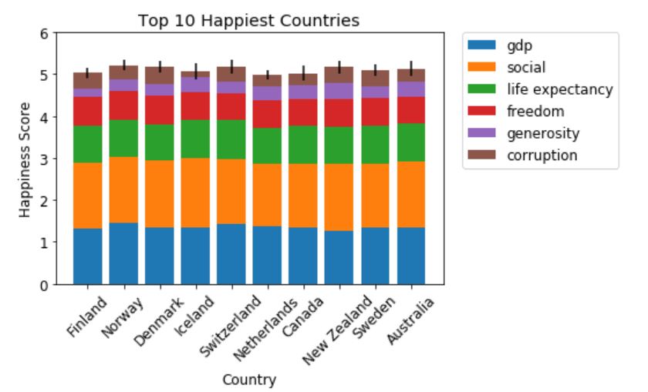
Conclusions
Happiness: breakdown
Happiest countries: Scandinavia (3) and (7) Europe

Slide 14
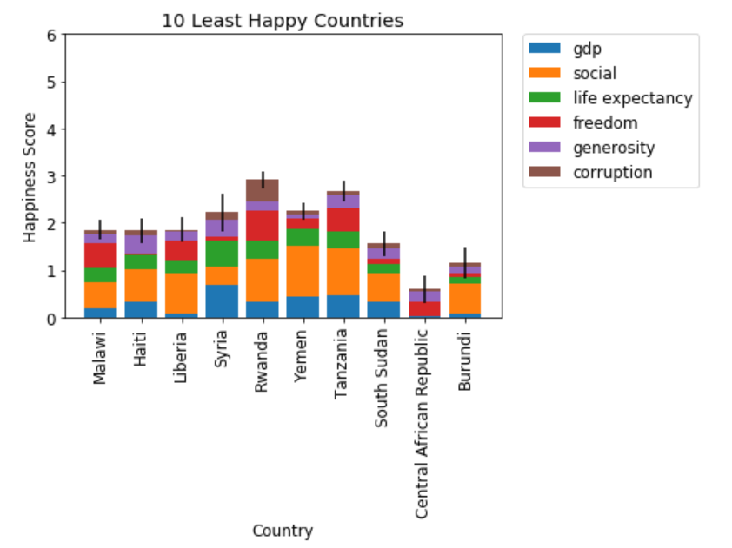
Conclusions
Happiness: breakdown
Least happy countries: Africa (9 of the bottom 10)

Slide 15

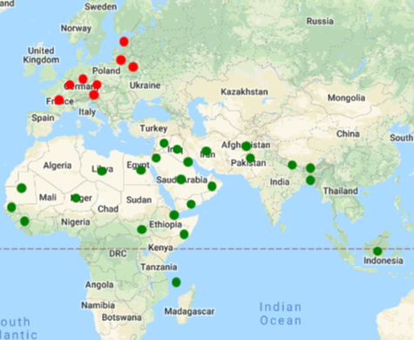
Conclusions
Alcohol Consumption: mapped
Which countries have the most alcohol consumption? Least?
Least alcohol: Somalia
Nearby Middle Eastern and North African countries
Most alcohol: Estonia
European countries – top 20 alcohol consumers (10+ liters / year)
most alcohol
12+ liters
least alcohol
>1 liter

Slide 16
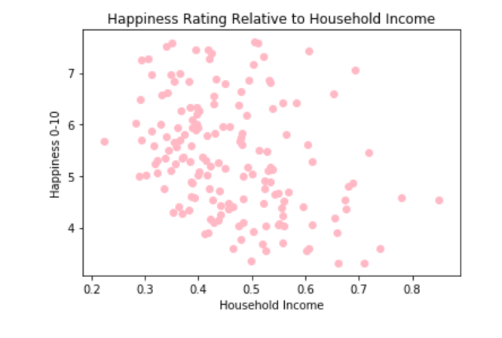
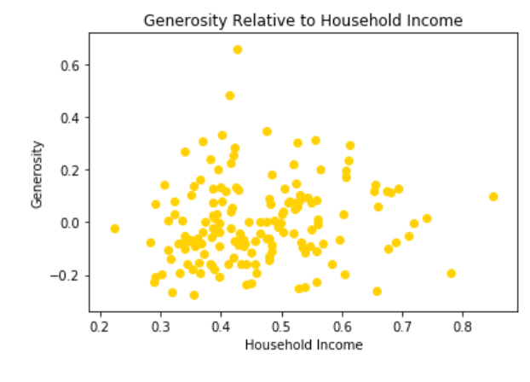
Conclusions
Happiness: factors
Analyzing GINI Index of Household Income, Generosity, Freedom to make life choices, and Alcohol
*
*
* GINI Index of Household income

Slide 17
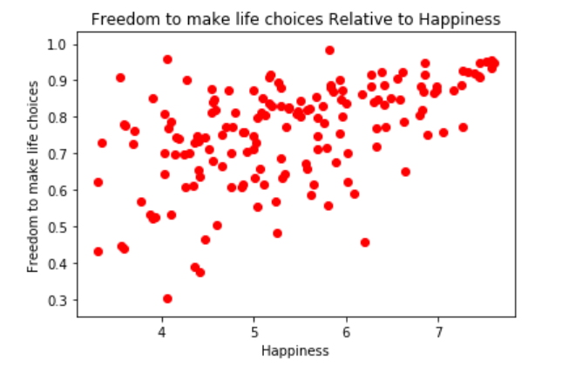
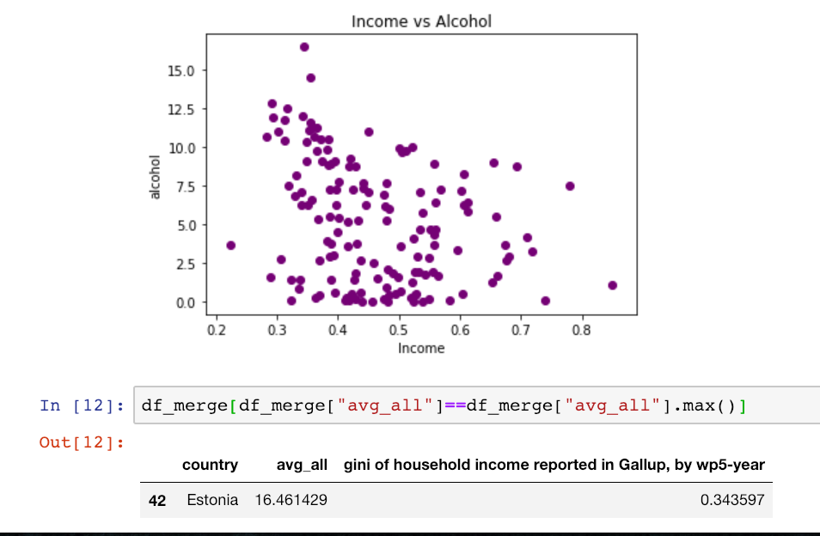
Conclusions
Happiness: factors
Analyzing GINI Index of Household Income, Generosity, Freedom to make life choices, and Alcohol
*
* GINI Index of Household income

Slide 18
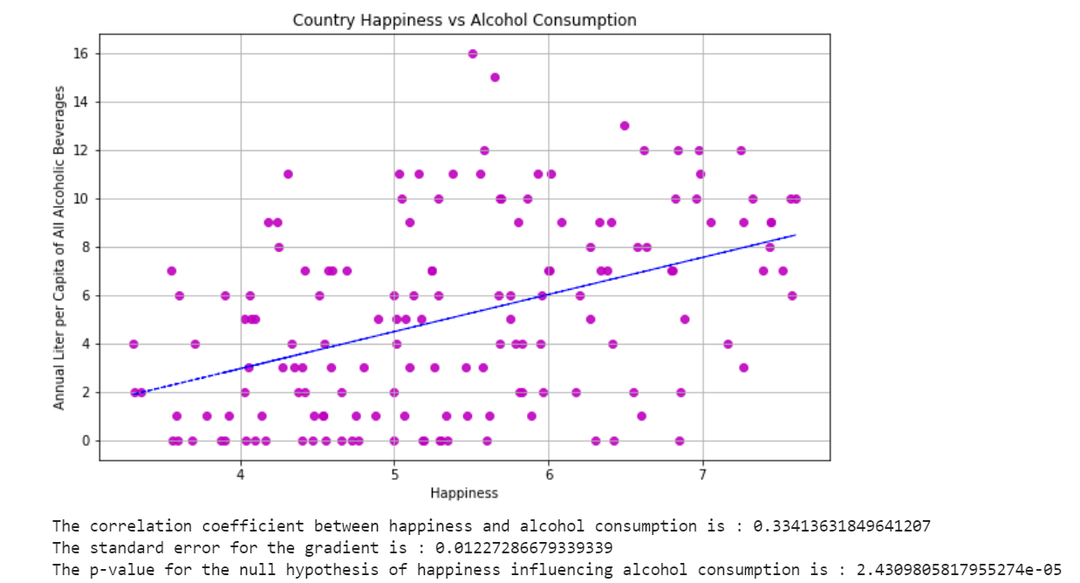
Conclusions
So, is there a correlation between alcohol consumption and happiness?
Weak Correlation (0.33)
Low p-value (0.00002)
Reject null hypothesis

Slide 19
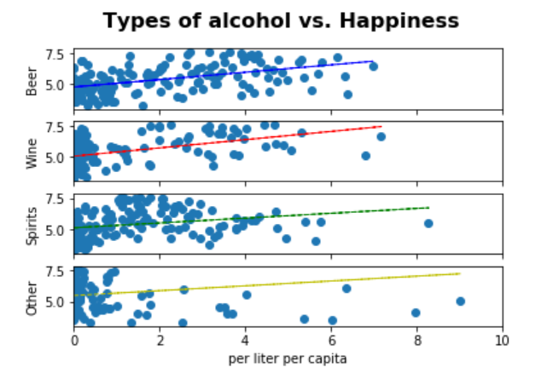
Conclusions
So, is there a correlation between types of alcohol and happiness?
Mild Correlation (~0.50) for beer and wine
But very low p-values (1e-10)
Can’t accept null hypotheses

Slide 20
In Summary
Implications, Limitations, Future Analyses
Implications
Geographical correlation for both happiness and alcoholic consumption tendencies
May be indicative of cultural, social, neighborly associations
Limitations
Signal vs. noise
Perhaps correlation between alcohol and happiness stronger if looking specifically at top/bottom quartile of each dataset
Future Analyses
Take quartile-specific sample from the data and run comparisons for alcohol vs. happiness
other indicators of happiness vs. alcohol
Whiskers
Notes:
If you look at the top /bottom countries for the alcohol and happiness data and compared just for that sample, the correlation appears that it may be higher. There may just be noise from the countries in the mid-range, where there is less of a correlation.

Slide 21
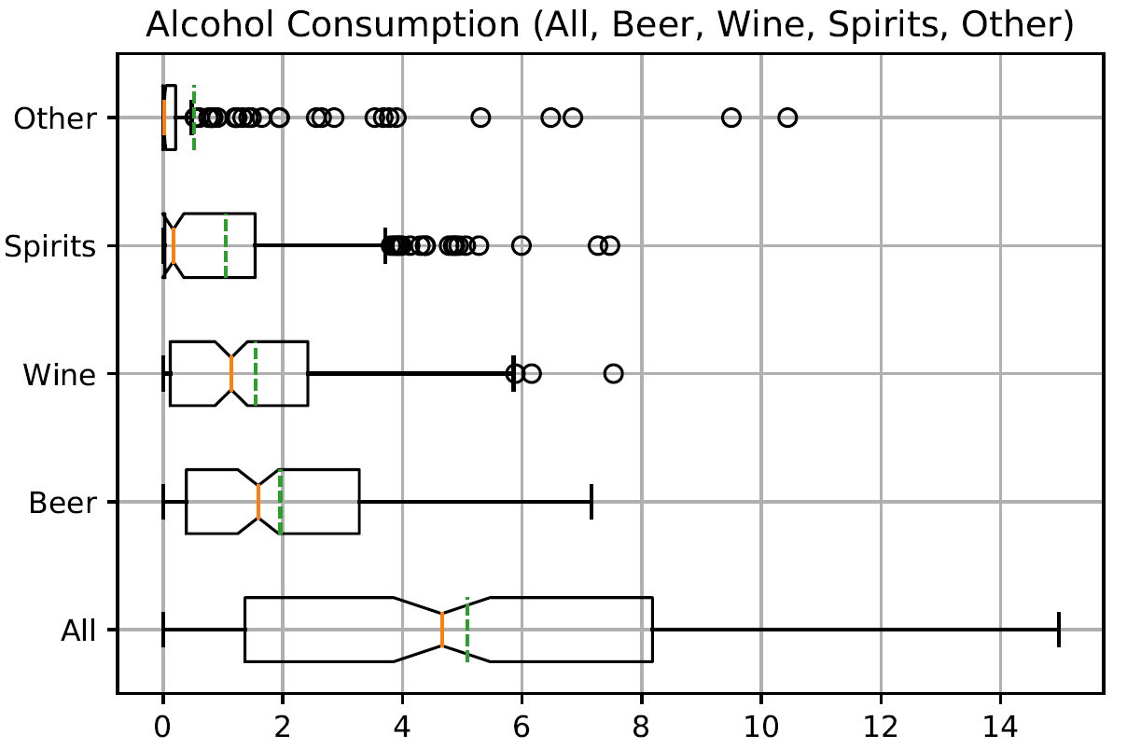
In Summary
Whiskers for thought

Slide 22
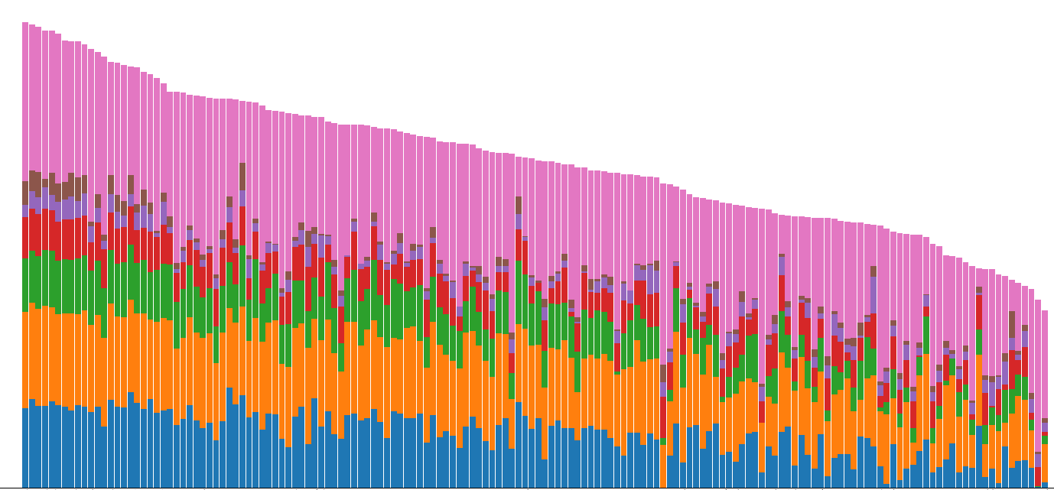
Questions?
We have your answers.

Slide 23
Additional Thoughts
Looks like we have extra time!
Which countries have the most income inequality?
South Africa has highest instance of GINI coefficient, but South America appears to have the highest concentration of income inequality, with countries such as Honduras, Brazil, Colombia, Paraguay, and making the top 10.
Countries with increased income equality were primarily located in Europe, with 4 of the 10 lowest GINI coefficient countries also being 4 of the 10 happiest nations.
Is there a correlation between income inequality and happiness?
The data shows a seemingly significant trend indicating that reduced income inequality correlates with increased happiness.
Is there a correlation between alcohol consumption and income inequality?
There appears to be a trend where reduced income inequality leads to higher alcohol consumption.

